Slide 1

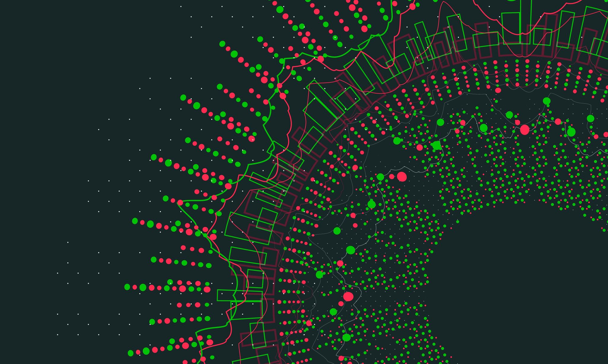
International Trade Balance
Juwon Lee,
Economics and Applied Statistics,
Yonsei University

Slide 2




Model for Trade Balance
Dataset is from KOSIS(Korean Statistical Information Service),
Exportation and Imporation from various countries, 2000-2022, monthly.

Slide 3
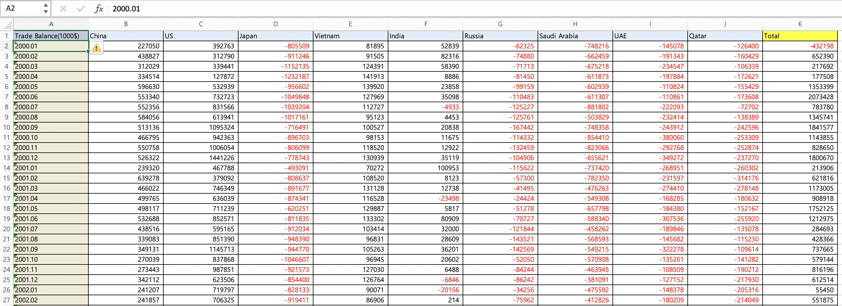
Dataset.csv

Slide 4
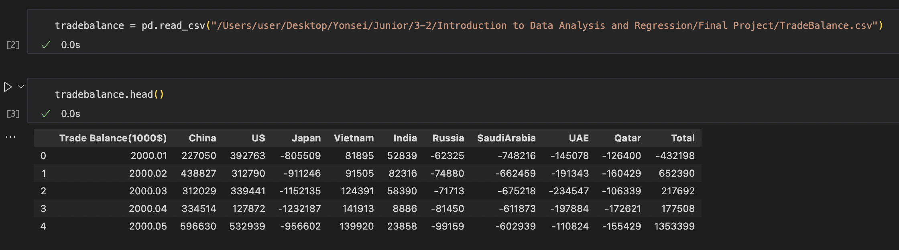

$$\hat{Trade Balance}=β_{0}+β_{1}China+β_{2}US+ …+β_{9}Qatar+e_{i} , i=1,…,9$$ Countries are chosen by the amount of trade between those and ROK.

Slide 5
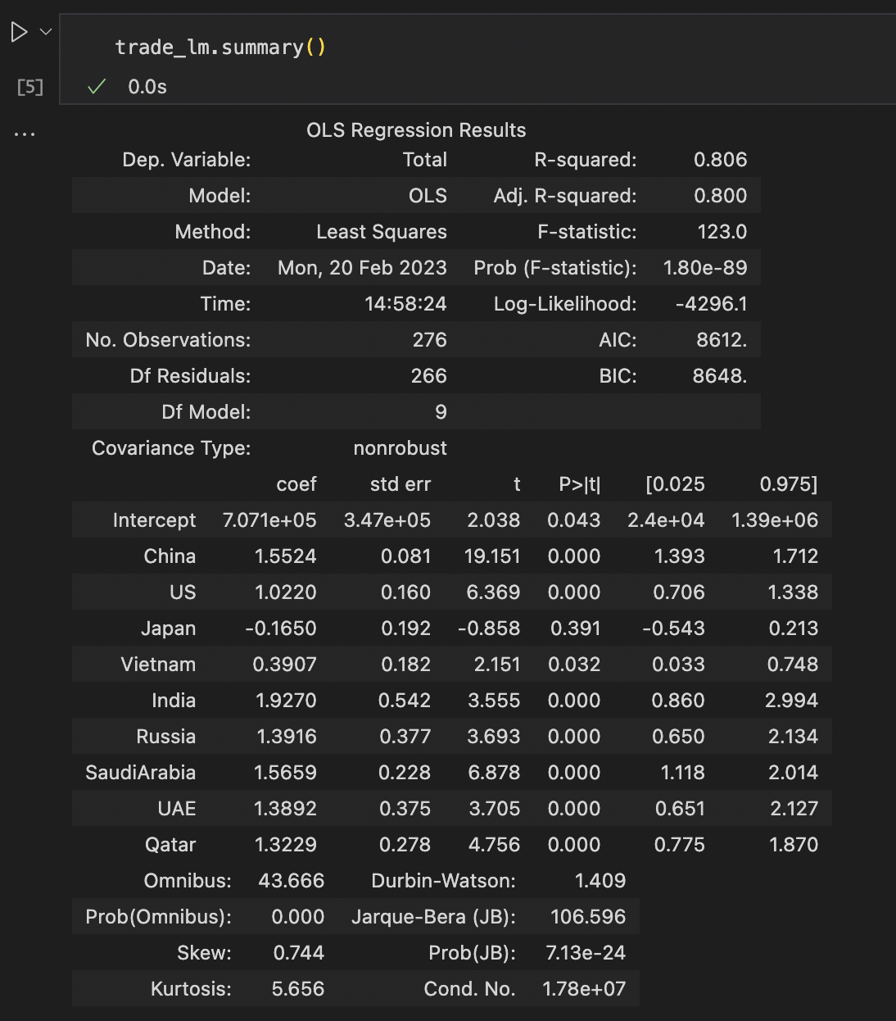
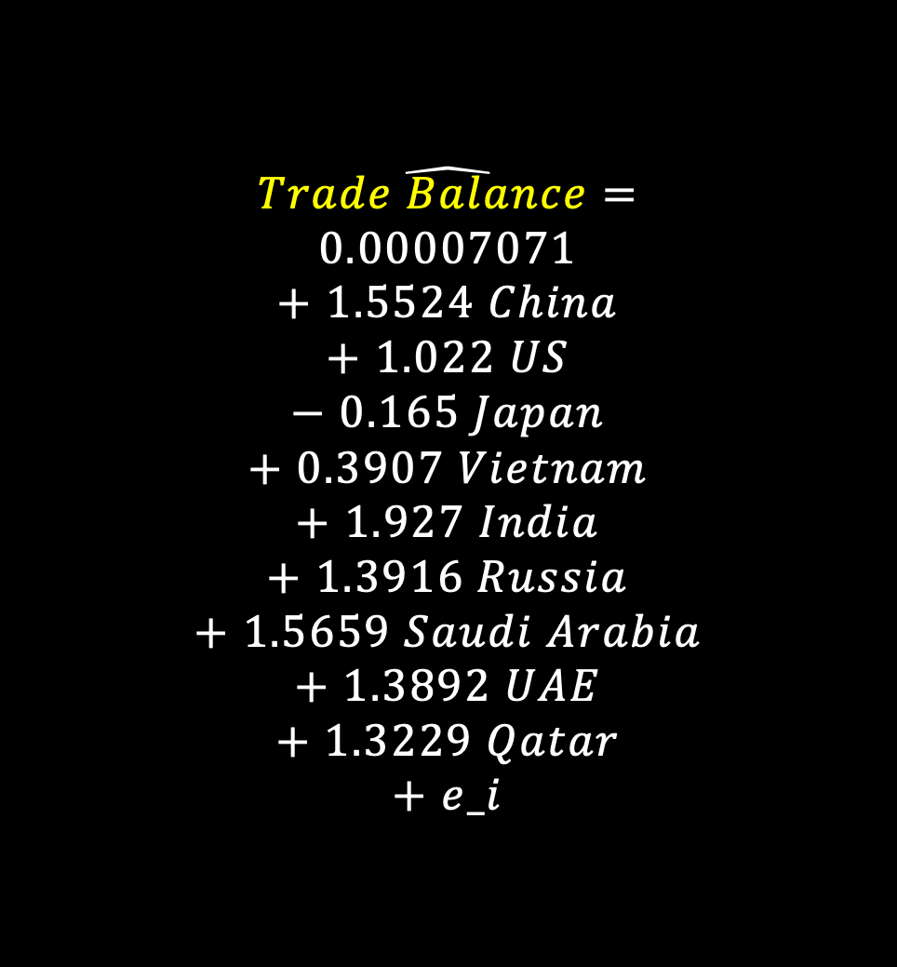
$$\hat{\begin{aligned}Trade Balance= \\ 0.00007071 \\ + 1.5524 China \\ + 1.022 US \\ − 0.165 Japan \\ + 0.3907 Vietnam \\ + 1.927 India \\ + 1.3916 Russia \\ + 1.5659 Saudi Arabia \\ + 1.3892 UAE \\ + 1.3229 Qatar \\ + e_i\end{aligned}}$$

Slide 6
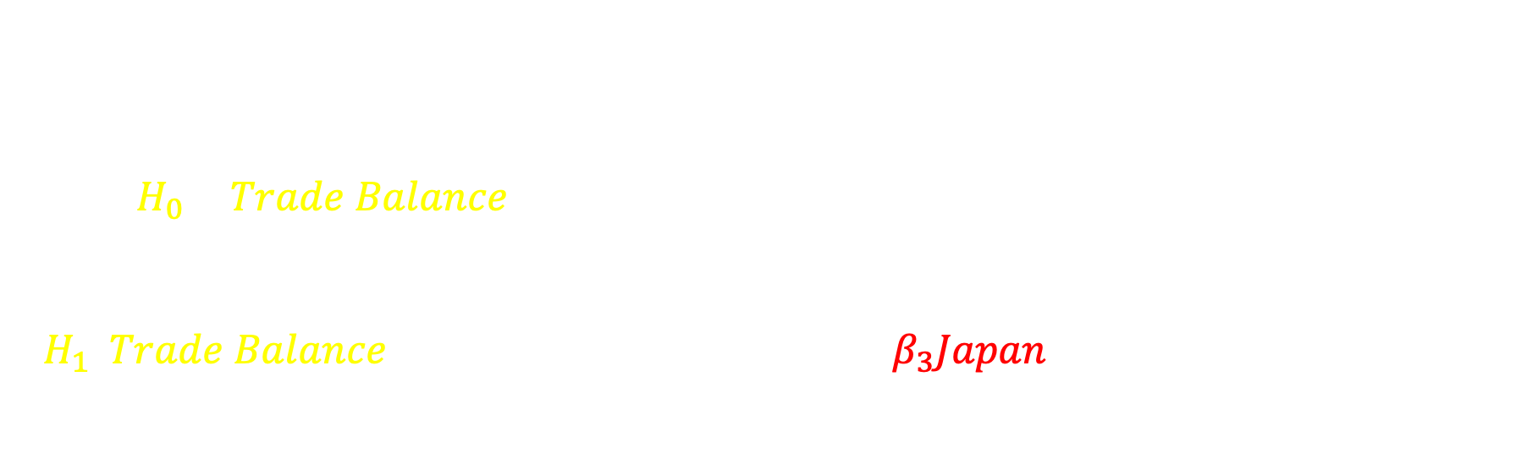
By the outcome of summary,
we can eliminate Japan, and make hypothesis as follows:
$$H_{0} : \hat{Trade Balance}=β_{0}+β_{1}China+β_{2}US+β_{4}Vietnam+β_{5}India$$
$$+β_{6}Russia+β_{7}Saudi Arabia+β_{8}UAE+β_{9}Qatar+e_{i}$$
$$H_{1}:\hat{Trade Balance}=β_{0}+β_{1}China+ β_{2}US+β_{3}Japan+β_{4}Vietnam+β_{5}India$$
$$+β_{6}Russia+β_{7}Saudi Arabia+β_{8}UAE+β_{9}Qatar+e_{i}$$

Slide 7
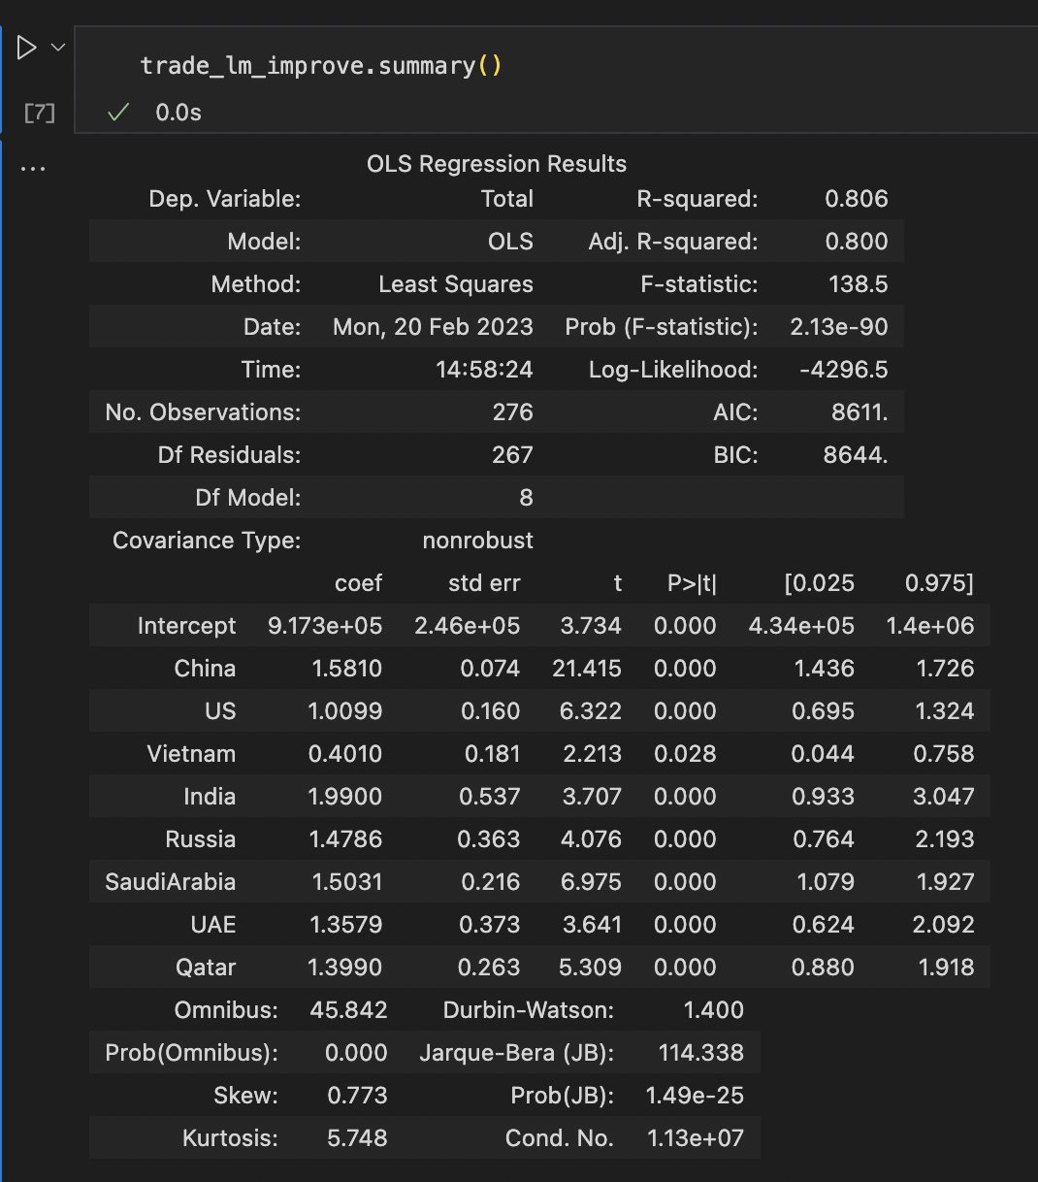
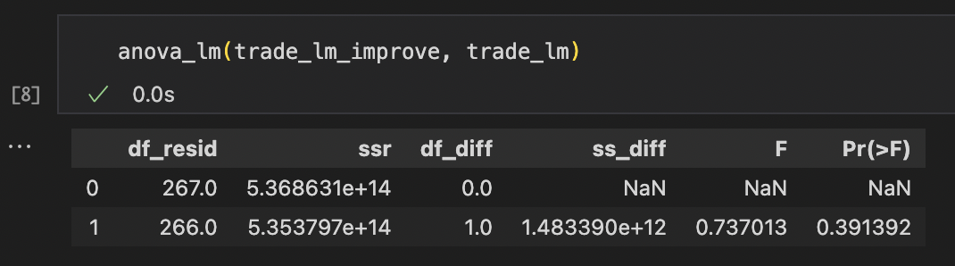
Thus, we cannot reject the null,
so that we can use the removed model,
without Japan.

Slide 8
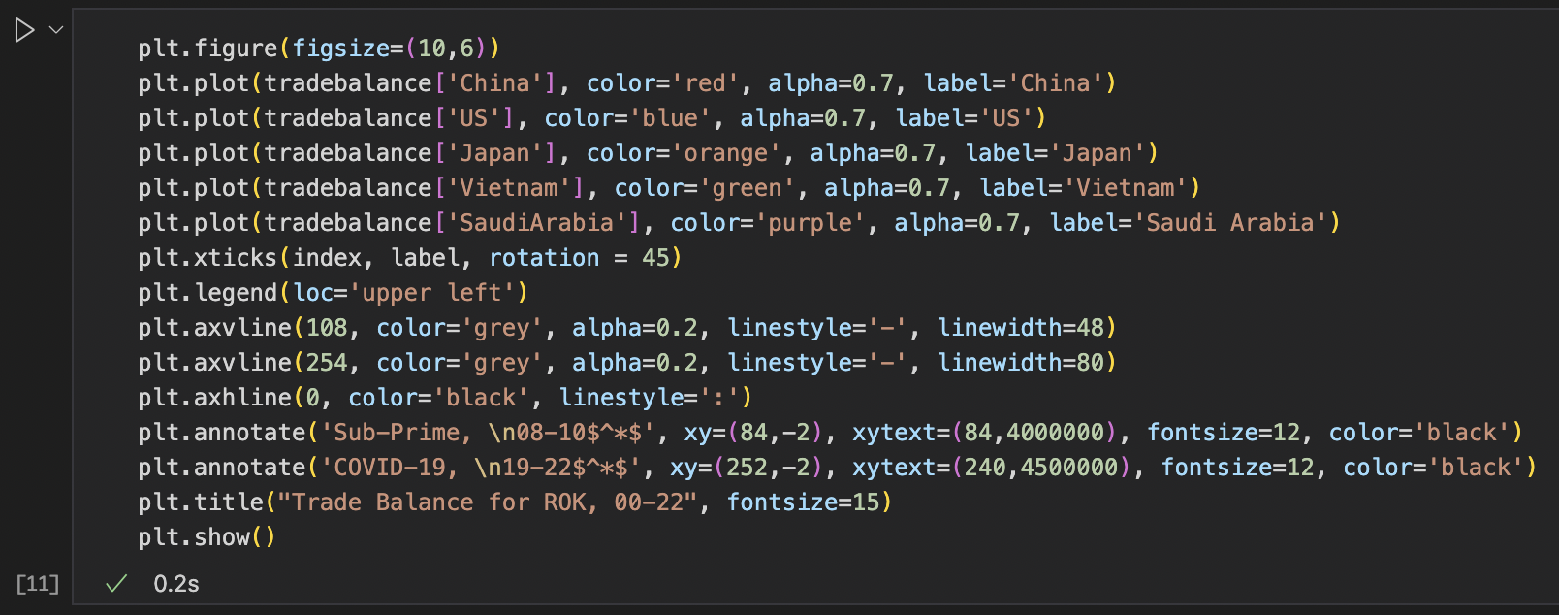
Appendix – Graphical Explanation

Slide 9
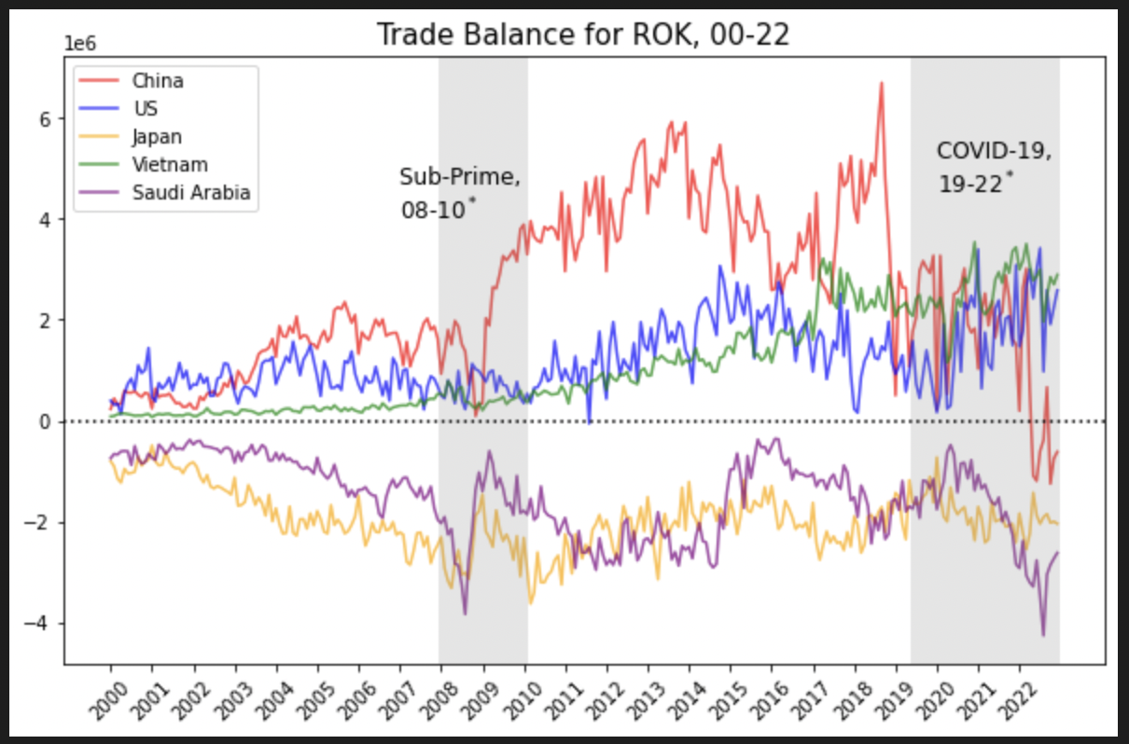
Thus, we can check the time-series analysis, too.

